Slide 1

Rethinking regex engines
to address ReDoS
James Davis
Notes:
ReDoS: Regular Expression Denial of Service

Slide 2
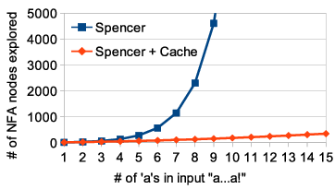
Background
Novel measurements
Regex: pattern-matching
Finite automata
ReDoS
Regex engines
Spencer and Thompson
Devs: 50% never need
Potential: L ≈ 95%
Actual: L ≈ 60%
Novel insight
Preliminary results
It’s not the backtracking
It’s redundancy
Memory → Linearity
Notes:
*This talk is divided into four parts: …
Background
Regular expressions, aka regexes, are an important technology for pattern-matching
Widely used in real software to match strings.
Common application areas: input validation, string manipulation
The fundamental operation with a regex is MATCH: within a given string, can we find the pattern that a regex encodes?
This is commonly described as “Does this regex match this string?”
For example, the regex “a+” (one or more a’s) would match the string aaa, but not the string xyz.
To implement this match, automata theory tells us that a regex can be converted into a Nondeterministic Finite Automaton (NFA) and optionally then into a Deterministic Finite Automaton (DFA).
A match is implemented by simulating the automaton (NFA or DFA) on the input, and reporting whether the simulation ends in a matching state.
Most of the regex engines built into programming languages have exponential worst-case match time.
This is a security problem: ReDoS
Last year I identified vulnerable super-linear regexes in sensitive places, including Django, Hapi, Python, Node.js, resulting in several CVEs and an acknowledgment from Microsoft
In June, CloudFlare…
Major CDN provider
12-hour outage in June 2019 due to a polynomial regex match, affecting a significant fraction of popular websites
Unfortunately, my paper at ASE’19 reports that many professional software developers do not know what ReDoS is and are not equipped to deal with it themselves. It would be great if we could address it at the systems level and do away with it entirely!
Why does this happen?
Regexes are implemented using regex engines.
Most programming languages implement their own engine.
Because the worst-case size of a DFA is exponential, all of the language engines I know of use an NFA simulation.
This includes JavaScript, Java, PHP, Python, Ruby, Perl, C#, Rust, and Go.
These engines follow two major algorithms: Spencer and Thompson.
Spencer engines use a backtracking-based depth-first search algorithm to search for a match.
Spencer permits the regex engines to support a broader range of features
But come at the cost of slower performance.
Most of the programming languages I just mentioned
Thompson engines use a breadth-first search instead, which can be thought of as an on-the-fly DFA construction.
Limited in the features they can support
But offer linear-time matches
Rust and Go
Novel measurements
The regex engines embedded in these programming languages have different worst-case match times.
Thompson-based engines have linear match times
But don’t support advanced features
Spencer-based engines have match times ranging from linear to polynomial to exponential, depending on the regex and the input.
But do support advanced features
This raises a natural question: Should regex engines emphasize support for these features?
1. In a survey of about 150 developers, I found that although almost all use regexes, half said they rarely or never need these advanced features.
2. I corroborated these response with measurements on an existing regex corpus of about half a million unique regexes.
My measurements show that 95% of real regexes DO NOT USE advanced features
They can be performed in linear time.
But up to 40% of real regexes, depending on the programming language, MAY TAKE POLYNOMIAL TIME OR WORSE anyway in existing Spencer-style engine implementations
Thus, the Spencer-style regex engines punish the common case – the 95% of regexes that use normal features – and are optimized for the uncommon case of advanced/unusual features
Pause, then summarize
So here is the situation:
Most regex engines have performance problems on typical regexes
This exposes a lot of software to potential security vulnerabilities
And these performance problems result from an implementation decision that doesn’t benefit most developers
I think we have enough evidence to rethink regex engines to address ReDoS.
However, we need to be practical: language developers are unlikely to make dramatic changes to integral language components, lest they risk torches and pitchforks due to problems with backwards compatibility.
The other work I presented here at FSE indicates that subtle semantic differences can arise between different regex engine implementations, and major algorithmic changes are begging for backwards compatibility issues.
So although the Thompson algorithm is attractive, and has been used in recent regex engines,
to addresses ReDoS in existing engines we will need to look for less drastic solutions.
Algorithmic insight
As I’ll show on the next slide, contrary to popular opinion, most super-linear matches are AVOIDABLE in a backtracking-based engine.
It is not backtracking, but rather redundancy within the backtracking implementation, that leads to super-linear match times.
At the cost of some memory, we can actually move those 95% of regexes from super-linear match times to linear-time ones.
And we can do so with an optimization rather than a major algorithmic change., avoiding semantic problems
Preliminary results: Things look good! More on that in a moment.

Slide 3

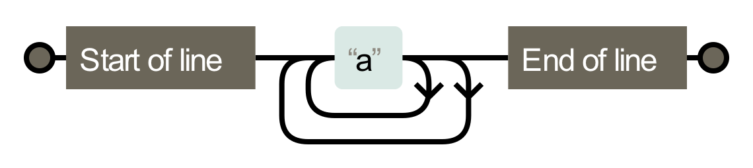
Spencer-style regex engine
Super-linear regex /^(a+)+$/
NFA
Malicious input “aaaaaaaaaa…aa!”
Mismatch
Exponential paths
Notes:
Let’s visualize the operation of a backtracking-based Spencer engine
Each time it sees an “a”, it doubles the number of paths it will explore.
This leads to exponential match times, potentially exposing the software to ReDoS.

Slide 4

Algorithmic insight
“aa…a!”
Node 1, offset 1
“a” (outer loop)
“a” (inner loop)
Node 1, offset 2
Node 1, offset 2
“a” (outer loop)
“a” (outer loop)
“a” (inner loop)
Node 1, offset 3
Node 1, offset 3
…
…
Notes:
*Here we have the same regex and input again
A Spencer-style backtracking regex engine tracks the current node and offset in the input, and pushes unexplored <node, offset> pairs into a queue to explore later.
When the engine encounters the first “a”, it has two choices.
Let’s suppose it advances south on the inner loop, and pushes the path along the outer loop into the queue to try later.
Suppose it keeps taking the inner loop, piling up the queue.
Eventually it finds no match along this path and begins working its way through the queue.
Note that the first entry in the queue – node 1, offset 2 – is a path it has tried already.
Exploring it would be redundant, but the regex engine does not remember this.
Most of the time, it is this redundant exploration that produces super-linear match behavior.
*If we instead marked each <node, offset> pair we consider, and check this visit cache before we search a node, we would be able to reduce the search to linear time,
at the cost of linear memory in the input and the NFA size.
Critically, I belive that introducing such a visit cache will not require significant modification to an existing regex engine.
We therefore believe that this approach is a practical one that regex engine developers may consider adopting to defeat ReDoS.

Slide 5
Preliminary results are promising!
Thank you for your attention
Notes:
As a prototype, we’ve implemented this visit cache in a simplified kernel of the regex language.
This kernel is representative of the regex features that 95% of regexes use.
On sample regexes and malicious inputs, our prototype can offer linear-time matches with a cache that grows linearly with the input and NFA size.
Median NFA size in the regex corpus: 10-15 nodes – so the matrix is expected to be 15 x N bits large, comparable to the size of the input itself (in bytes).
I am looking forward to extending my prototype to a larger regex language, and will then evaluate the costs of incorporating this technique into a real regex engine.
I hope that someday soon, ReDoS will be a thing of the past.
*Thank you for your attention. I would be happy to take any questions you have.

Slide 6
Bonus material
Notes:
Let me start by introducing some background material.

Slide 9
What are regexes used for?
30-40% of Python and JavaScript projects
Diverse purposes
User-agent string → Server-side rendering
Source code → Linters
File names → Command-line tools
Tokens → Lexers
HTML → Browser plug-ins
Email → Input validation
Notes:
Generally speaking, regexes are a means of encoding a string language.
They use a domain-specific language to describe a subset of all possible strings.
Regexes are widely used, estimated to appear in 30-40% of Python and JavaScript projects.
They are used for diverse purposes.
Our prior empirical work has identified many common application areas, including
X, used in Y

Slide 10

Some regex examples
/^a+$/ ← Some ‘a’
/\d{1,3}\.\d{1,3}\.\d{1,3}\.\d{1,3}/ ← IPv4
/^[a-zA-Z0-9]+([._]?[a-zA-Z0-9]+)*$/ ← Username
Notes:
In case it’s been awhile since you worked with regexes, let me refresh your memory with some examples.

Slide 11

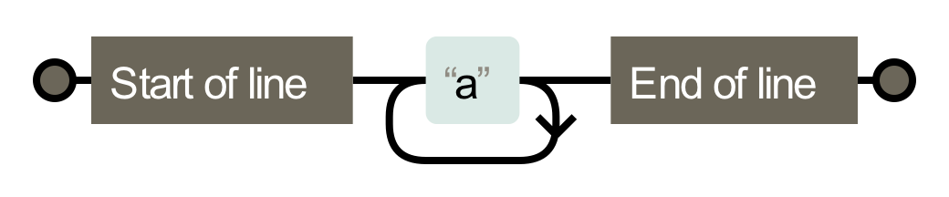

Regex engines
What are they?
match(regex, string) ← “Does this regex match this string?”
How do they work?
/^a+$/
Simulate on input
“aaa”

Slide 12
ReDoS Regexes
Simple ReDoS regex /^(a+)+$/
NFA
Malicious input “aaaaaaaaaa…aa!”
Recurrence relation
T(n) = 2*T(n-1)
= 2*(2*T(n-2))
= O(2^{n})
Mismatch
Exponential paths
Notes:
A ReDoS regex is a special kind of regex whose worst-case behavior
is polynomial or exponential in most regex engines.

Slide 13



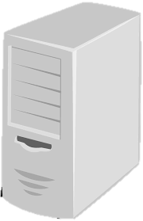


Regular Expression Denial of Service (ReDoS)
[C&W ‘03]
/^[a-zA-Z0-9]+([._]?[a-zA-Z0-9]+)*$/
“aaa…aaaa!”
“Susie”
Malicious input injected
[DWL ‘18]
[S&P ‘18]
Notes:
Suppose the server is using Microsoft’s ReDoS regex for usernames that I mentioned earlier.
Killing a server:
Users like Susie are sad.
If this is Outlook mail, then millions of customers can’t check their email.

Slide 14
Research
Notes:
TODO

Slide 15
Research questions
Empirical motivation
Are super-linear regexes actually used in practice?
Is this super-linear behavior necessary or an implementation artifact?
Constrained system design
Can we improve the performance of common engines
…without introducing semantic concerns?
Notes:
We divided our research questions across three themes.
*The first theme was qualitative: what do developers think and do during regex development?
*In our second theme, we corroborated the re-use practices that developers described by measuring regex re-use in open-source software.
*In the third theme, we empirically evaluated the regex portability problems that developers might encounter, considering both semantics and performance.
----
Our experiments covered two aspects:
Semantic portability: When and why do regexes have different semantics across ProgLangs -- match different sets of strings in different programming languages?
Performance portability: When and why do regexes have different worst-case performance in different programming languages?

Slide 16
Spencer and Thompson NFA simulation
Notes:
TODO

Slide 17
Empirical motivation Analyzing a regex corpus
Notes:
Developers reported regex re-use practices, copy/pasting regexes from other source code (e.g. their company’s mono-repo), and from Internet sources like Stack Overflow.
To corroborate this characterization of practice, we collected a polyglot regex corpus and measured the extent of regex duplication between software projects written in different programming languages.

Slide 18








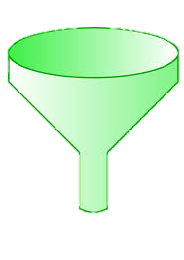


Regex collection methodology
Module regex extraction
Module selection
Unique regexes
Top 25K
Notes:
We collected regexes like this.
For each language, we identified the largest module registry.
We mapped those modules to GitHub and sorted them by the number of GitHub stars they have, which gave us a registry-independent measurement of importance.
For each of the top 25K modules, we statically extracted regexes from the master branch.
This gave us a set of unique regexes for each module, which we merged into a larger corpus.

Slide 19



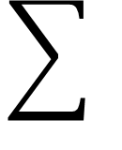
Regex corpus
Num. modules
Unique
regexes
25K
150K
”
20K
”
45K
”
45K
193K modules
580K unique regexes
”
150K
”
20K
All (30K)
140K
All (10K)
2K
Notes:
In total, we extracted regexes from 193K modules written in 8 programming languages.
After accounting for duplicates, this gave us a polyglot corpus of about half a million unique regexes.
---
193,524 modules
As you can see, we found more regexes in some languages than others.

Slide 20

Performance methodology
SL regex detectors
Per-lang. complexity
Notes:
This brings us to the second part of our experiments: portability differences.
Prior research has shown that regex matches can have linear, polynomial, or exponential complexity in the length of the input.
This match time can vary by language for the same regex and input, based on the algorithm that a language’s regex engine uses to perform the match.
However, we don’t have a good picture of the differences between the regex engines in each language, so we checked experimentally.
Why does this matter?
Well, suppose a regex is copied from a language in which it has linear performance to one in which it has polynomial or exponential performance.
This introduces a potential security vulnerability.
If this regex is used in server-side code that handles client input, then an attacker could trigger this algorithmic complexity and perform a Regular Expression Denial of Service attack.
To understand the algorithmic complexity differences between the regex engines in each language, we used an ensemble of four super-linear regex detectors to identify possible super-linear behavior. Then we used our per-language regex testers to check the worst-case behavior in each language, labeling each regex as linear, polynomial, or exponential in the worst case.

Slide 21
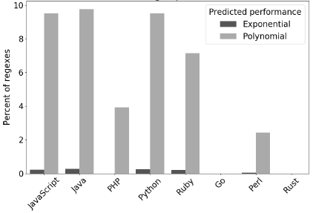
10% of regexes are super-linear
Notes:
In building our regex corpus, we tracked the regexes extracted from each module.
To understand regex re-use, we measured the extent of re-use between the modules in our registry sample.
This chart plots the percent of modules that contained a complex regex that appeared in more than one module.
We report that
*In 20% of all modules, we found a complex regex that appeared in some other module, in the same or a different programming language,
*About 7% of the corpus modules contain a complex regex that appears in more than one language,
and
*5% of the corpus modules contain an exact copy of a regex we found on Stack Overflow
These measurements generally corroborate the description of regex practices from our survey.
It appears that the developers of open-source software also copy-paste regexes, including across language boundaries.
----
By complex I mean it is at least 15 characters long -- and thus unlikely to be independently derived.
Although some of these regexes may have been derived by other means – independent creation, whole-sale file duplication, etc. …

Slide 22
(Empirical) Portability Semantic + Performance Differences
Notes:
In the first set of research results, I reported that developers say they re-use regexes across language boundaries.
Just now, I showed that measurements on our corpus corroborate their report.
These findings made us wonder: What might go wrong with this regex re-use practice?
To answer this question, we ran two “what-if” experiments to understand the possible problems empirically.
We studied both semantic and performance differences.
By a semantic difference, I mean that a regex matches different sets of strings in different languages.
By a performance difference, I mean that a regex takes a noteworthily different amount of time to complete a match – some change in the worst-case complexity.

Slide 23

What-if experiments using regex testers
match regex against input
if match:
emit matched substring
emit capture groups
else:
report “no match”
/(\d+).\d+/
&
3.14
Match
substring “3.14”
capture “3”
Notes:
To perform our what-if experiments, we used a common set of regex testers.
The regex testers all follow the same simple algorithm: …
We implemented this algorithm in each of these languages.
*As an example, suppose we have the regex … and the input “3.14”.
*This regex will match the input. It will match the substring “3.14” – the whole string, in this case.
The regex contains one capture group, the integer prefix of the string, and our tester will also emit the contents of this group.

Slide 24


Semantics: Methodology
Rex, MutRex, EGRET, ReScue, BRICS
Input generators
Both match? | Same substring? | Same captures?
Regex testers
Language semantic analysis
(pairwise)
Notes:
Here is the methodology we used to identify semantic portability problems.
*To measure semantic differences, we needed a set of inputs to determine the strings a regex matches and the strings it does not match.
We used five state-of-the-art regex input generators to generate input.
Using our input generator ensemble, we produced about 2500 unique inputs for the median regex.
*We then fed these inputs to our regex testers and collected the results.
*To analyze, we compared the results for each pair of languages.
COMPARING the results matches can produce four distinct outcomes:
First row: They both mismatch, or they match and agree on everything (no disagreement)
They both match, agree on the matched substring, but disagree about the contents of capture groups
They both match, but report that different substrings matched
One matches and the other does not
When two languages disagree on the behavior for a (regex, input) pair, we call this a “difference witness”.
Difference witnesses fall into one of three categories: capture, substring, and match witnesses.
-----------
ReScue: modified to emit the randomized inputs it explores in its search for super-linear behavior
BRICS: modified to emit random subsets of inputs instead of an exhaustive set (infinite / very large for our purposes)

Slide 25
Copy/pasting regexes leads to semantic differences
8% had a match witness
4% had a substring witness
7% had a capture witness
In total, 15% of regexes (82K) had a difference witness
Notes:
We identified at least one difference witness for 15% of the regexes.
These are regexes that compiled in some pair of languages but disagreed in some way about the match.
Among those:
8% of the regexes had a match witness
4% had a substring witness
7% had a capture witness
This means that, ceteris paribus, about 15% of the time a developer copy/pastes a regex across a language boundary it will have different behavior in the new programming language. Assuming the behavior of the regex in the old language was “correct” according to application semantics, some regex porting will be required.

Slide 26

Some sample results of semantic differences
Witness | Language 1 | Behavior 1 | Language 2 | Behavior 2
\cC |  | ctrl-C |  | “cC”
^a |  | Begin input |  | Begin line
a++ |  | Possessive quantifier |  | Quantifier
[ ] ] |  | “]” |  | Empty capture group
Undocumented behaviors
Notes:
The full details of the differences we identified are in the paper, but I’d like to show you some illustrative findings here.
The first behavior is the “expected” behavior (normal across several languages), while the second behavior is the “surprising” behavior – unique to the language or shared by a few.
Regex engines are complex and under-specified, and not all of these behaviors were documented.
We found that there’s no substitute for actually evaluating regexes in different languages and comparing how they behave.

Slide 27
Performance methodology
SL regex detectors
Per-lang. complexity
Notes:
This brings us to the second part of our experiments: portability differences.
Prior research has shown that regex matches can have linear, polynomial, or exponential complexity in the length of the input.
This match time can vary by language for the same regex and input, based on the algorithm that a language’s regex engine uses to perform the match.
However, we don’t have a good picture of the differences between the regex engines in each language, so we checked experimentally.
Why does this matter?
Well, suppose a regex is copied from a language in which it has linear performance to one in which it has polynomial or exponential performance.
This introduces a potential security vulnerability.
If this regex is used in server-side code that handles client input, then an attacker could trigger this algorithmic complexity and perform a Regular Expression Denial of Service attack.
To understand the algorithmic complexity differences between the regex engines in each language, we used an ensemble of four super-linear regex detectors to identify possible super-linear behavior. Then we used our per-language regex testers to check the worst-case behavior in each language, labeling each regex as linear, polynomial, or exponential in the worst case.

Slide 28
Performance results
Notes:
This chart shows the percent of regexes in each language that exhibited exponential and polynomial worst-case behavior.
As you can see, we identified three distinct families of performance:
JS, Java, Python, and Ruby
PHP and Perl
Go and Rust
The “Slow” and “Medium” engines use variations on Spencer’s algorithm, while the “Fast” engines use Thompson’s algorithm.
Details about the algorithms used in the three classes are in the paper.
The implication: Moving regexes from a fast language to a medium one, or from a medium to a slow one, may be dangerous from a security perspective.
----
We expected to see two classes of performance:
“Slow” regex engines that use a backtracking-based algorithm, and
“Fast” regex engines that use Thompson’s BFS algorithm.
We see these two classes, as well as a “Medium” class for PHP and Perl.
We studied the implementations of PHP and Perl’s regex engines, and identified the defense mechanisms that enable them to handle more regexes quickly.
Details are in the paper.

Slide 29
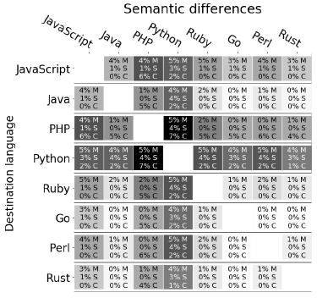
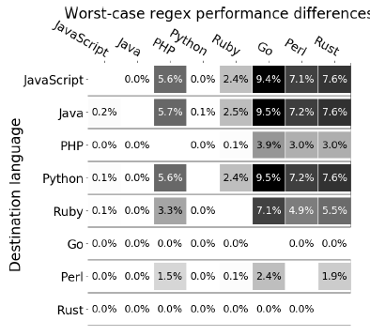
Summarized in developer-friendly heatmaps
Notes:
We think a good way to visualize our experimental findings is through heatmaps illustrating the pairwise semantic and performance differences between languages,
The darker the cell, the riskier it is to move regexes from that source to that destination.
We hope these will benefit practitioners thinking about copy/pasting regexes.

Slide 30
Closing Remarks

Slide 31
Regexes are not a lingua franca
Survey: developers say they believe and act like they are
Empirical re-use study: regexes are re-used
Portability experiments: Correctness, security concerns
Thank you for your attention
Notes:
* survey
* Empirical corroborates
But
*Our portability experiments demonstrate the correctness and security concerns that may arise from this practice.
Takehome message
On the whole, we believe our study shows that:
Regexes are a misunderstood programming language feature
There is tons of room for more research in this space; come join us!

Slide 32


Bonus material

Slide 33
False negatives in the SL regex detectors
The SL regex detectors are using fullMatch semantics
Regex engines sometimes implement partialMatch…unwisely
Thus, and somewhat horrifyingly:
/(a+)b/ may be super-linear
Equivalent to the fullMatch /^.*?(a+)b/ ← QOA

Slide 34
Why not applications?
Open-source applications may not be representative of code in industry
Module ecosystems are shared by open-source and industry
Modules are sometimes authored by industry as a way to give back to the open-source community

Slide 35
Why git projects instead of artifacts?
Bundling / Obfuscation complicates analysis on registry artifacts

Slide 36
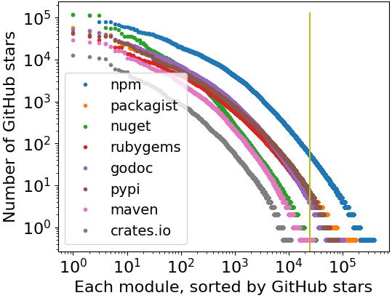
Cut-off point for “popular modules”
First 25,000 modules
JS: ~60 stars
Others: <10 stars
Rust: 13K modules

Slide 37
Registries and Languages
Notes:
TODO Missing Java, Golang; and in the wrong order
Python: Pypi
JavaScript: npm
Rust: Crates
PHP: Packagist
Perl: CPAN
Ruby: Rubygems
Java: Maven central
Go: (TODO)

Slide 38
Why modules, not applications?
Modules are comparable building blocks
Strings
Math
Command-line scripting aids
Graphics
We think modules are
more comparable across languages
than applications would be.

Slide 39
Getting modules from a registry
API: “All module metadata”
API: “Modules by first letter”
Filter for github.com URLs
API: Per-module info
465,030 modules
Filter for github.com URLs
100,954 modules

Slide 40
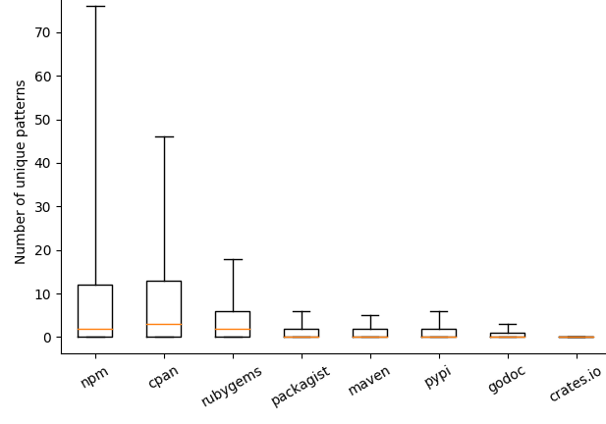
Unique regexes per module

Slide 41
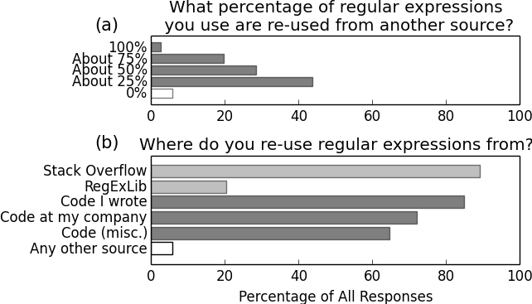
Regex re-use practices

Slide 42
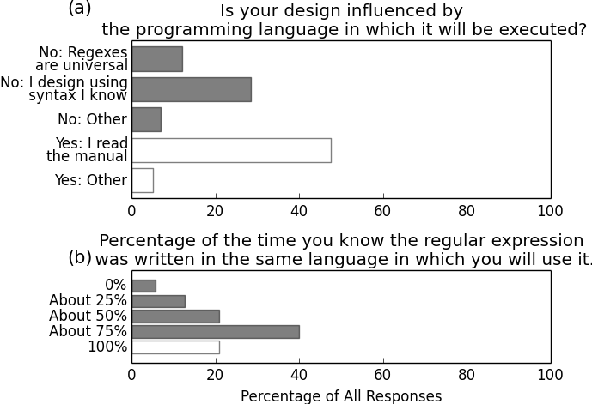
Regex portability beliefs

Slide 43
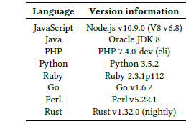
Language versions used in experiments

Slide 44
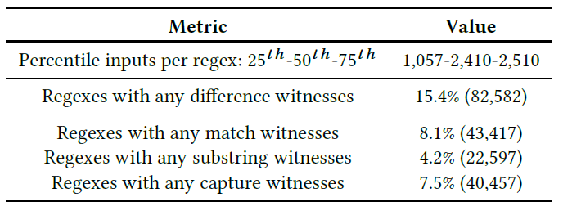
Input generation results
Notes:
Half of these had match witnesses (match vs. mismatch), a third had substring witnesses, and half had capture witnesses.

Slide 45
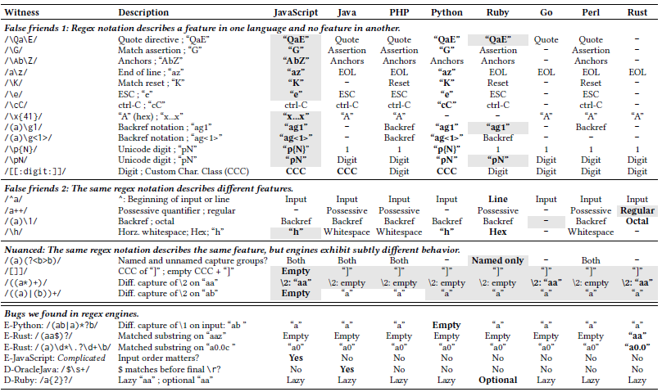

Slide 46








Analyzing Regexes
350K
60K
1. ReDoS regexes
2. Degree
[R&T ‘14]
[WMBW ‘16]
[WOHD ‘17]
3.6K
(1%)
704
(1%)
13K
(3%)
705
(1%)
Notes:
TODO This is just filler
1. ReDoS Regexes
Talk through flowchart.
From this we learn that ReDoS regexes occur a lot in practice – thousands of ReDoS regexes occurring in over 10K modules.
ReDoS regexes make these modules, as well as any modules and applications that depend on them, potentially vulnerable to ReDoS.
2. Degree
We wanted to know how concerned developers should be about these regexes.
Exponential behavior is rather more problematic than polynomial behavior.
We measured match time on varying-length inputs.
Then we fitted exponential and polynomial curves to the data.
We chose the curve of best fit.

Slide 47
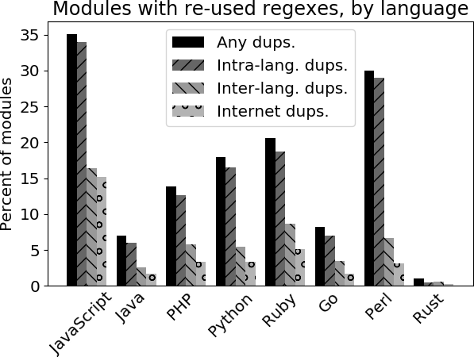


Regex re-use in modules (“Complex” regexes)
Every language has complex regexes
that appear in other languages
Systems languages
Regexes are rare
Duplication is rare
JS: Highest re-use rates
Notes:
This chart shows the extent of regex duplication between the modules in our registry sample.
In keeping with the phrasing in our survey (“copy/pasting regexes”), we label as re-use any pair of identical regexes (string equality).
To eliminate trivially identical regexes like /\s/, we conservatively require any matching regexes to be at least 15 characters long. While it is possible that two developers might independently produce the same (longer) regex, this seems unlikely given that hundreds of distinct regexes have been reported in prior work even for “simple” languages like emails.
*Explain the metrics
*Indicate that JS has the highest re-use on each metric, and use this to explain each bar height.
*Contrast the “scripting” languages (higher regex USE and RE-USE) with the compiled/systems languages (lower regex USE and RE-USE).
*Key point here: cross-language re-use appears in every language, including, interestingly, across languages.
5% of all modules contain regexes also found on SO or REL

Slide 48
Regex collection methodology
Module regex extraction
Module selection
HEAD • static analysis
Unique regexes
Top 25K
Notes:
TODO: Update numbers
TODO: Star counts as a proxy for popularity that would be consistent across languages
TODO: Modules, not applications?
Walk through the flow-chart

Slide 49
Comparing specifications (in the form of language documentation) was a starting point, of course.
But regex engines are complex and under-specified,
so there’s no substitute for actually evaluating regexes in different languages and comparing how they behave.

Slide 50
As it turns out, both engines have defense mechanisms to avoid long-running regex evaluations.
They both use a counter-based scheme to short-circuit long-running evaluations with an exception.
In addition, Perl maintains a limited backtracking cache to avoid some redundant searches.
As you can see, neither defense mechanism is complete; there is still polynomial and exponential behavior to be found there.
But these mechanisms may be a good idea for other regex engine maintainers to consider.

Slide 51
(Some) Limitations and Future Work
xxx
Notes:
Of course, our work has some limitation
ns.

Slide 52
Some regex examples
/^a+$/ ← Some ‘a’
/\d{1,3}\.\d{1,3}\.\d{1,3}\.\d{1,3}/ ← IPv4
/^[a-zA-Z0-9]+([._]?[a-zA-Z0-9]+)*$/ ← Username
Notes:
Generally speaking, regexes are a means of encoding a string language: some subset of all possible strings
In case it’s been awhile since you worked with regexes, let me refresh your memory with some examples.

Slide 53
What are regexes used for?
30-40% of Python and JavaScript projects
Diverse purposes
User-agent string → Server-side rendering
Source code → Linters
File names → Command-line tools
Tokens → Lexers
HTML → Browser plug-ins
Email → Input validation
Notes:
Regexes are widely used, estimated to appear in 30-40% of Python and JavaScript projects.
They are used for diverse purposes.
Our prior empirical work has identified many common application areas, including
X, used in Y

